Slide 1

Mobile Sales Analysis
A visual exploration of key insights gleaned from our Power BI dashboard, highlighting key performance indicators and actionable trends for mobile sales.

Slide 2
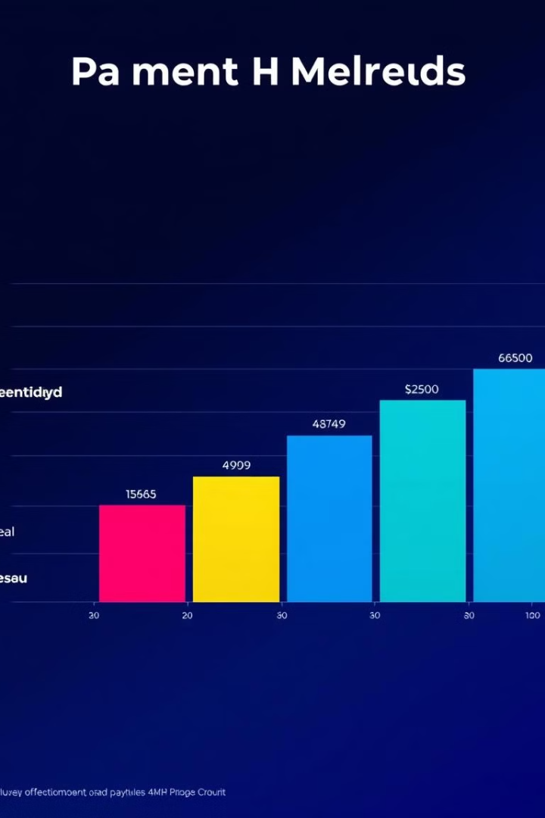
Payment Method Breakdown
Payment Method Breakdown
Key Takeaways
Analyze performance by payment method to optimize processing and customer experience.
Visualizing profit distribution across different payment methods, identifying trends and opportunities.

Slide 3
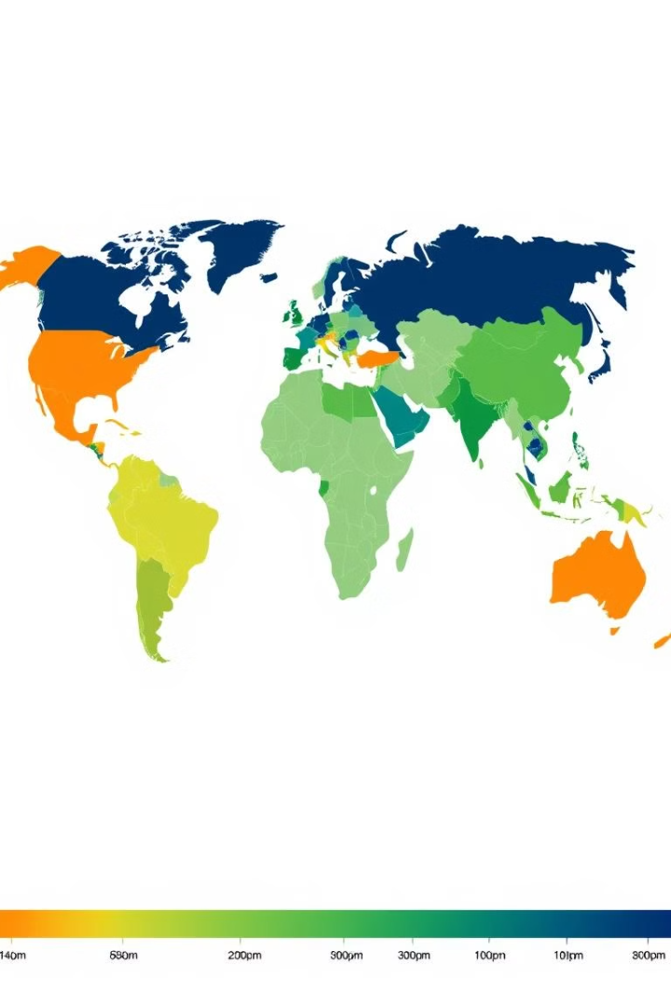


Operating Profit by Country
Profit Distribution
Revealing regional profit disparities and highlighting areas with potential for improvement.
1
Growth Strategy
Focus on expanding market presence in high-profit regions and optimizing performance in underperforming areas.
2

Slide 4
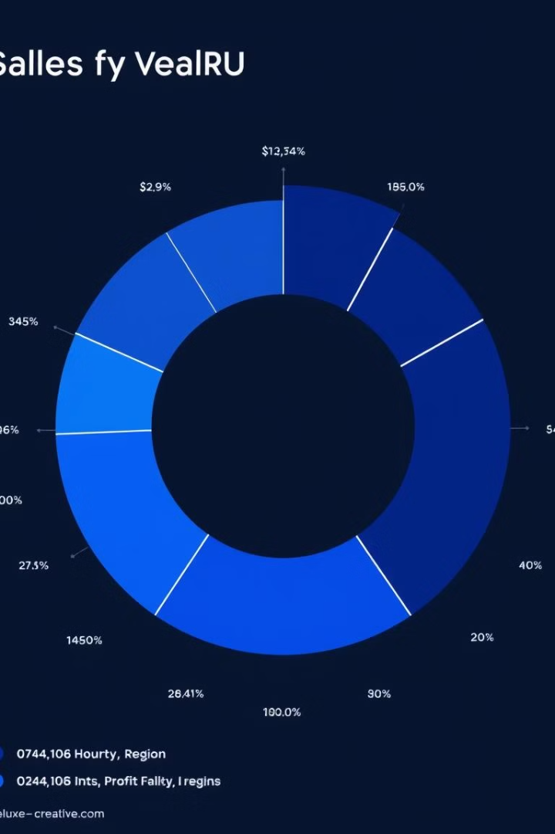


Sales and Profit by Country
Regional Performance
Analyzing sales and profit performance across different geographic regions, revealing key trends.
Strategic Focus
Identify regions with high profit margins and prioritize sales efforts in those areas.

Slide 5
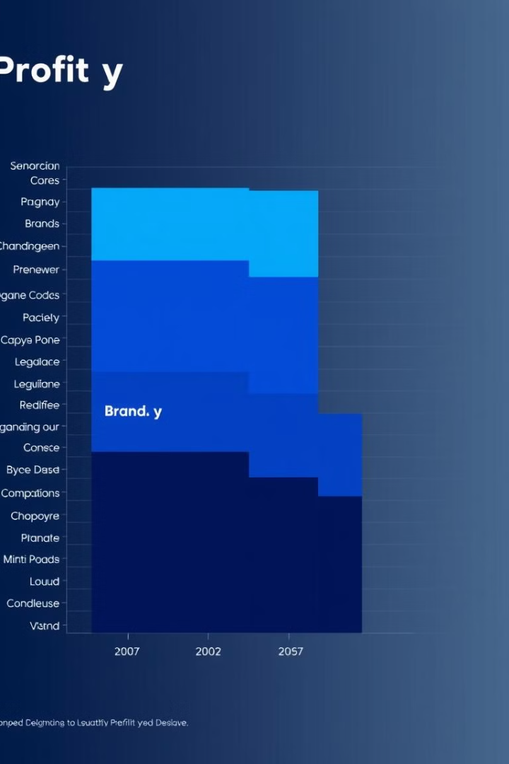


Brand Performance
Target Market
Strategic Optimization
Analyze brand performance based on profit contribution and identify key strengths and weaknesses.
Prioritize investments in high-performing brands and focus on improving underperforming ones.

Slide 6

Key Insights for Mobile Sales
1
Profit by Region
2
Payment Method Optimization
Focus on high-profit regions for growth and invest in underdeveloped markets.
Improve customer experience and reduce processing costs by analyzing payment method performance.
3
Brand Performance
Prioritize investments in high-performing brands and focus on improving underperforming brands.

Slide 7

Next Steps
We will use these insights to inform our mobile sales strategy, adjust our marketing efforts, and optimize our operations for enhanced profitability.

Slide 8

Mobile Trends
The global mobile device market is constantly evolving, presenting both opportunities and challenges for businesses. Understanding key trends is crucial for optimizing sales strategies and staying ahead of the competition.

Slide 9
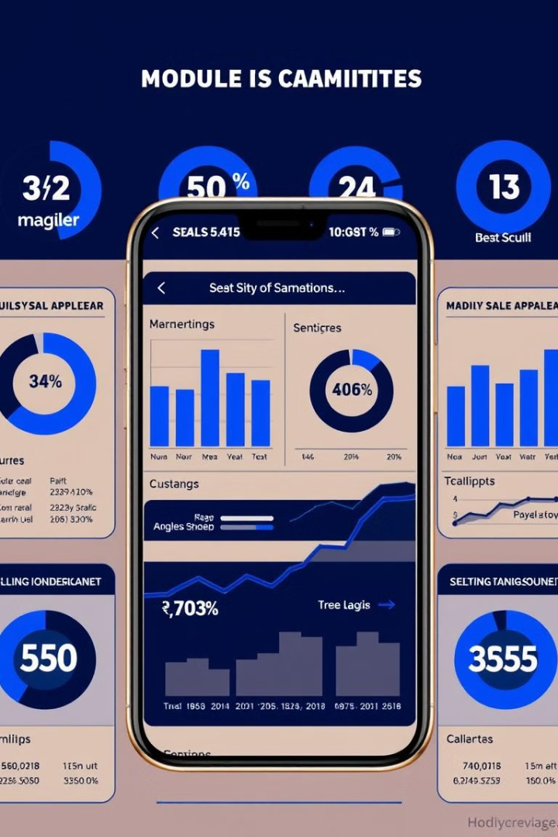
Key Takeaways
By analyzing mobile sales data, we can identify key trends and opportunities for growth.
1
Region-Specific Growth
2
Payment Method Optimization
Focus on high-profit regions for expansion.
Enhance customer experience and reduce processing costs.
3
Brand Performance
Prioritize investments in high-performing brands
Our analysis reveals significant opportunities to optimize mobile sales strategies, focusing on high-profit regions and streamlining payment processing. We will prioritize investments in top-performing brands and address underperforming areas. This data-driven approach will drive enhanced profitability and position us for sustained growth in the dynamic mobile market.

Slide 10

conclusion
Our analysis reveals significant opportunities to optimize mobile sales strategies, focusing on high-profit regions and streamlining payment processing. We will prioritize investments in top-performing brands and address underperforming areas. This data-driven approach will drive enhanced profitability and position us for sustained growth in the dynamic mobile market.

